Slide 1

Navigating the Quantum Threat: An Introduction to Post-Quantum Cryptography

Slide 2
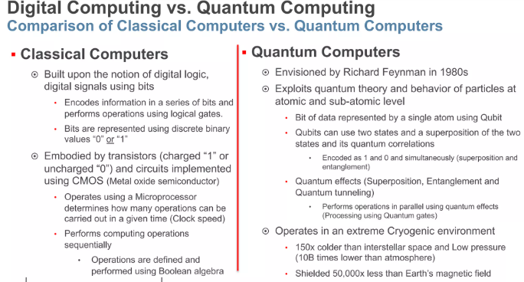

Slide 3
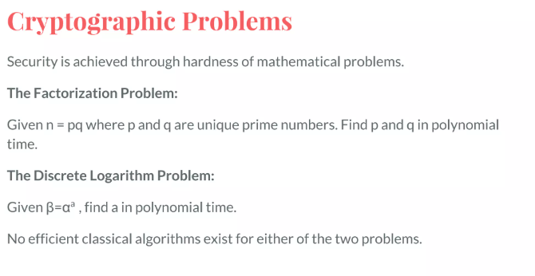

Slide 4
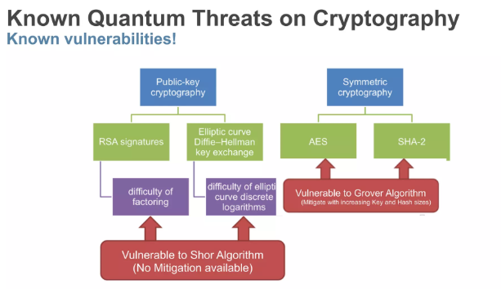

Slide 5
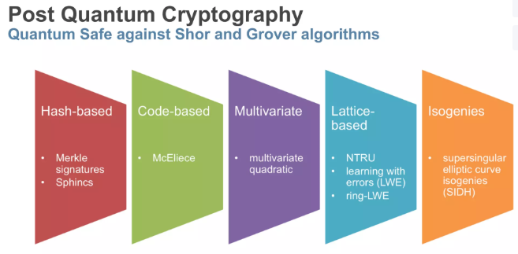

Slide 6
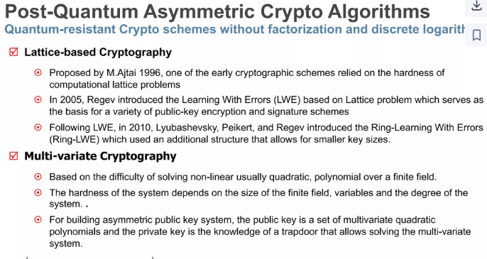

Slide 7
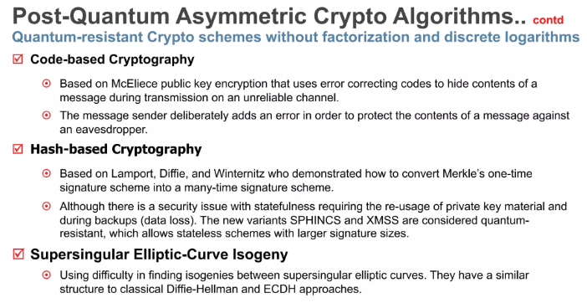

Slide 8
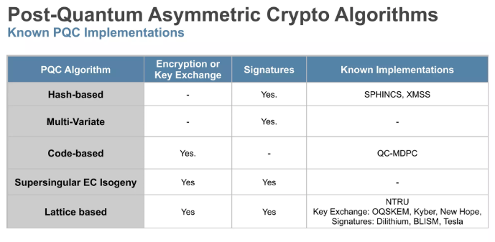

Slide 9
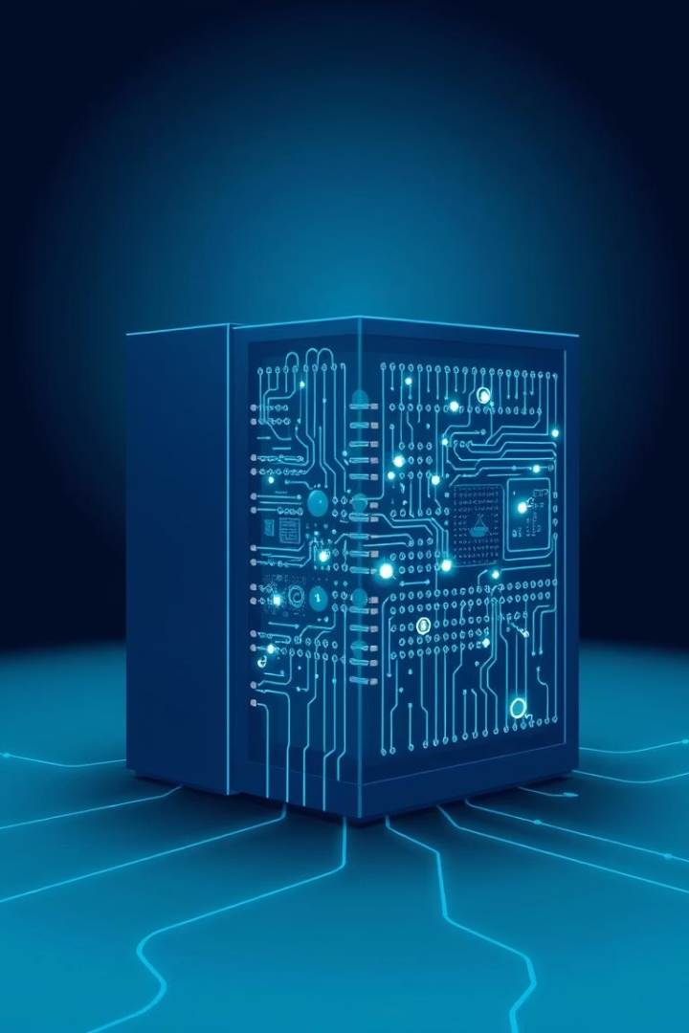
The Quantum Computing Threat
Quantum Advantage
Quantum computers use principles of superposition and entanglement.
Shor's Algorithm
Efficiently breaks RSA and ECC cryptographic systems.
Grover's Algorithm
Speeds up brute-force searches against symmetric keys.
Timeline
Quantum supremacy is projected as early as 2030.

Slide 10
Impact on Current Cryptography
Vulnerable Systems
Symmetric Keys
Financial Risk
RSA
Less impacted but require longer keys for security.
Quantum hacks could cause over $20 billion in damage within 5 years.
Elliptic Curve Cryptography (ECC)
Diffie-Hellman key exchange

Slide 11

Defining Post-Quantum Cryptography (PQC)
Quantum-Resistant Designs
Mathematical Foundations
Diverse Approaches
PQC is a suite, not a single algorithm solution.
Secure against both quantum and classical computer attacks.
Relies on problems that quantum algorithms can’t efficiently solve.

Slide 12

PQC Algorithm Families
Lattice-Based
Uses Module Learning With Errors (MLWE) problems.
Code-Based
McEliece encryption scheme is prominent here.
Multivariate
Algorithms like Rainbow based on multivariate polynomial problems.
Hash-Based
Signature schemes such as SPHINCS+ rely on hash functions.

Slide 13
Lattice-Based Cryptography
Core Principle
Key Algorithms
Pros & Cons
Security based on the hardness of lattice problems.
Kyber for key exchange
Strong security proofs
Dilithium for digital signatures
Efficient implementations
Larger key sizes than ECC

Slide 14
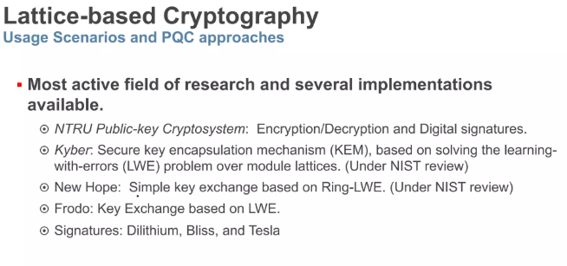

Slide 15
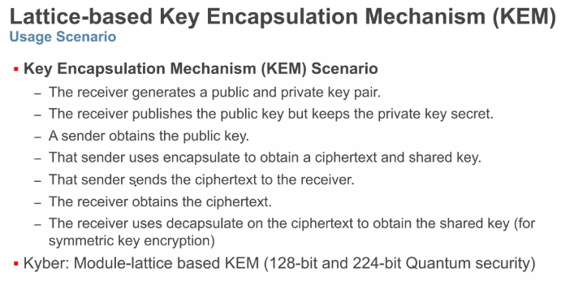

Slide 16
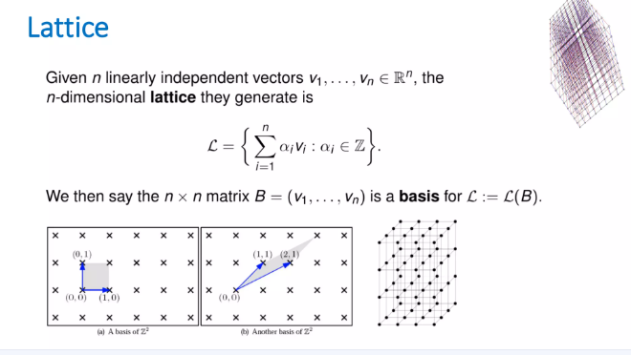

Slide 17
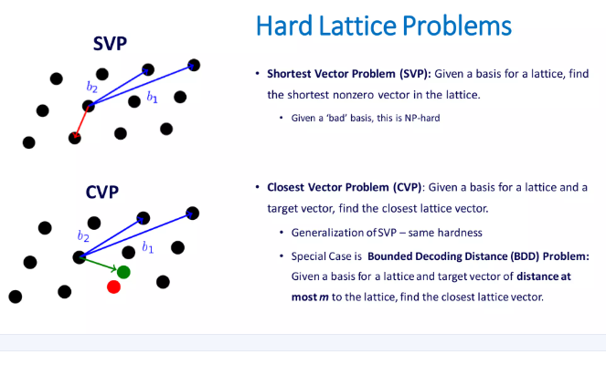

Slide 18
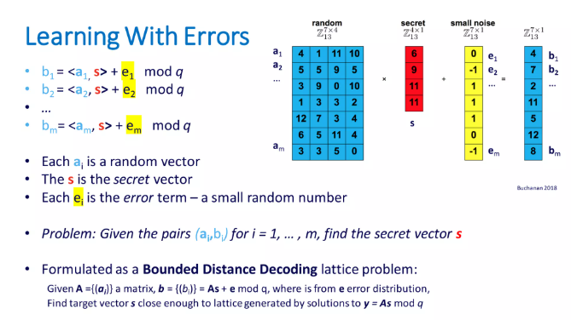

Slide 19
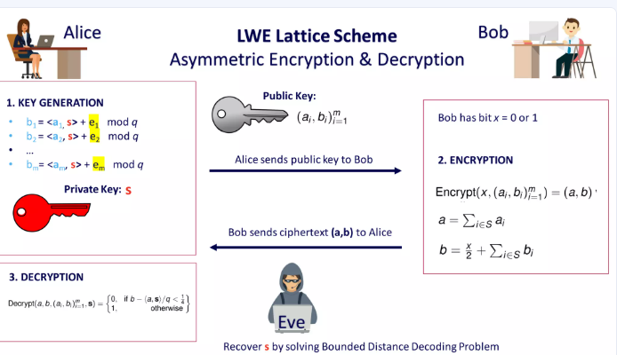

Slide 20
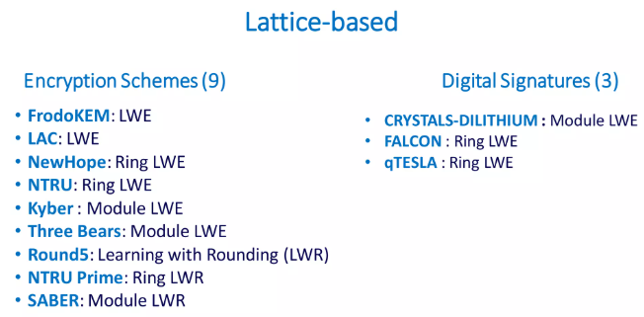

Slide 21
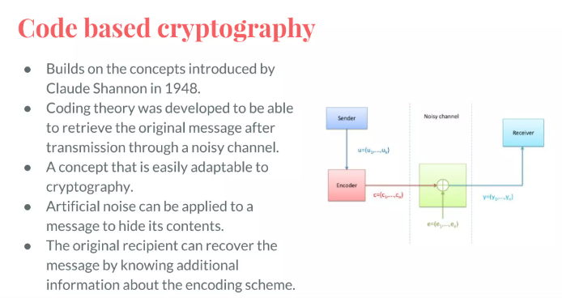

Slide 22
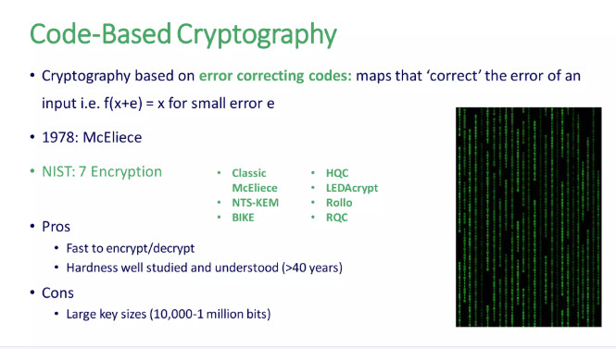

Slide 23
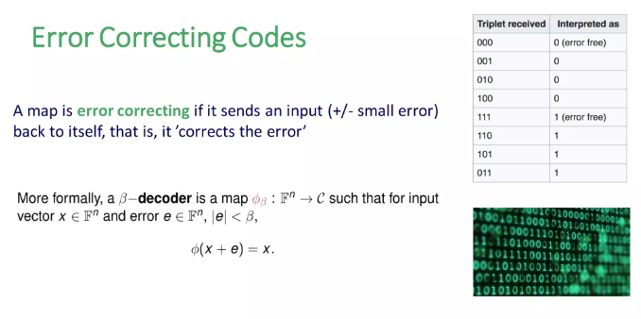

Slide 24
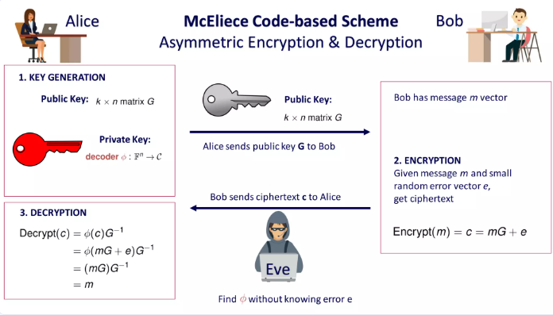

Slide 25
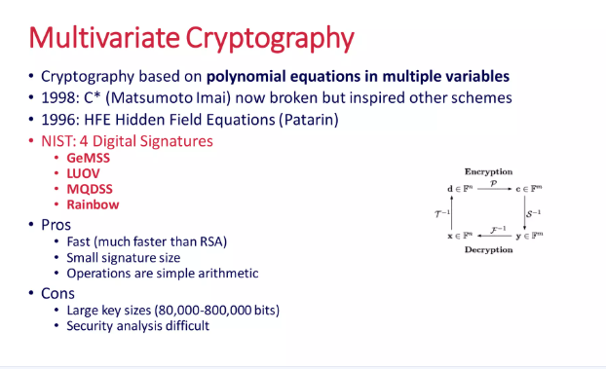

Slide 26
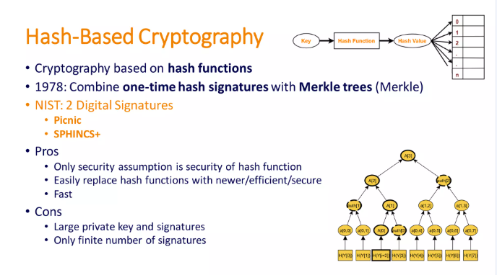

Slide 27
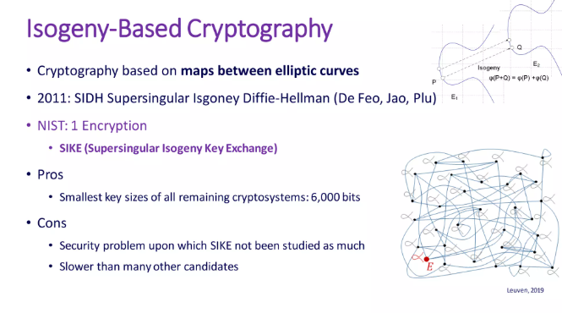

Slide 28
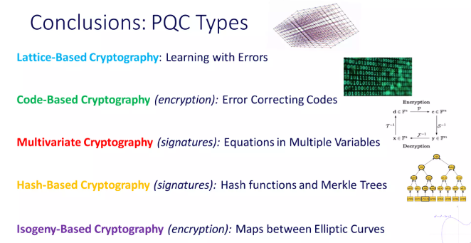

Slide 29

NIST's PQC Standardization Process
1
Started in 2016
2
2022 Winners
To evaluate new post-quantum algorithms.
CRYSTALS-Kyber, CRYSTALS-Dilithium, Falcon, SPHINCS+ chosen.
3
Ongoing Review
4
Transition Timeline
Round 4 candidates assessed for specific use cases.
Migration expected from 2024 to 2025 onwards.

Slide 30
Migration and Implementation Challenges
Compatibility
Performance
Infrastructure
Hybrid Approaches
Integrating PQC with legacy systems is complex.
New algorithms have higher computational overhead.
Requires key management and hardware upgrades.
Combining classical and PQC ensures smooth transition.

Slide 31





Real-World Applications and Adoption
Finance
Government & Defense
Healthcare
IoT & Infrastructure
Leading companies like Google, Microsoft, and IBM are adopting PQC measures globally.

Slide 32
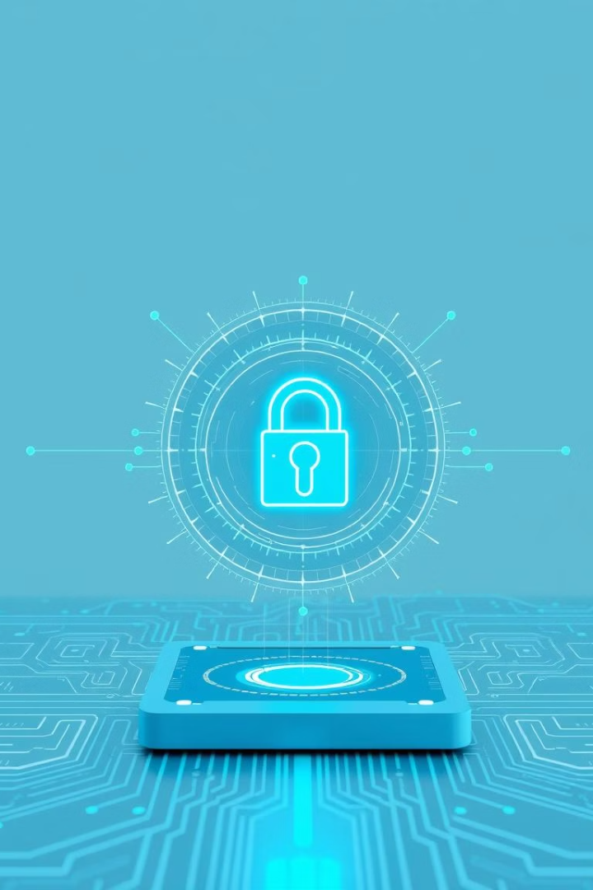




The Future of Post-Quantum Cryptography
Continued Research
Developing more efficient and secure algorithms.
Hardware Acceleration
Enhancing speed and performance of PQC operations.
Quantum Key Distribution
Integrating with PQC for layered security.
Quantum-Safe Future
Ensuring secure communications in a quantum era.

